Slide 1
THE OPERATOR'S HANDBOOK
Working With Me
How I work — and exactly what to expect.
Julio Domingo Salvador
COO & Operations Leader · Executive Assistant / Chief of Staff
Bacolod, Philippines · Remote worldwide

Slide 2
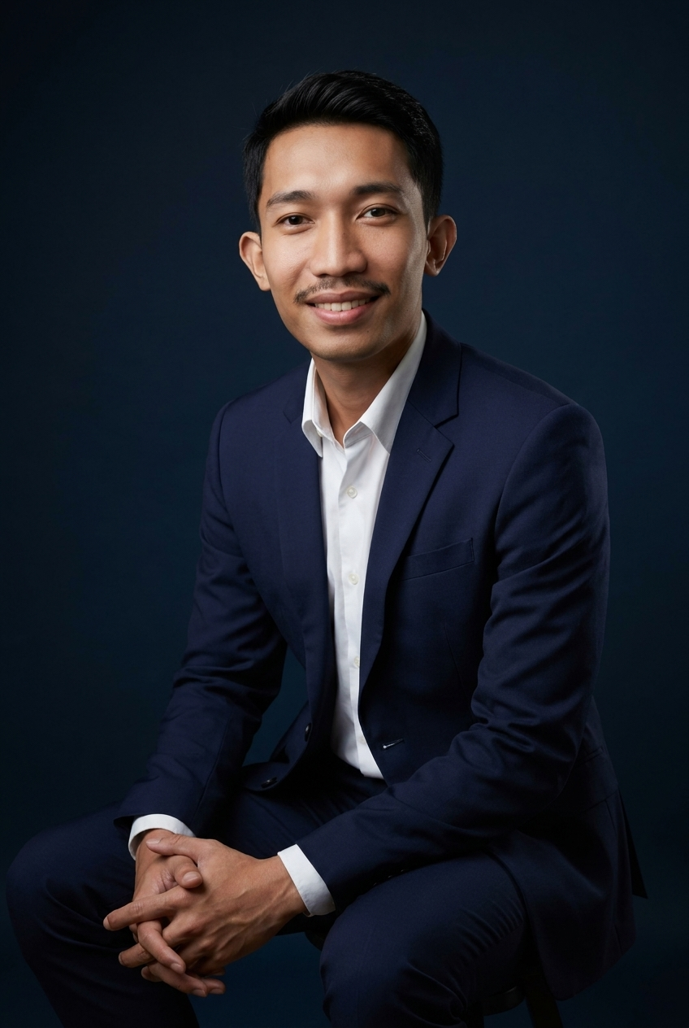
01 · WELCOME
First, the honest version of who I am.
I'm an operations leader who turns founder chaos into calm, repeatable systems — then builds the tools that run them. MBA-trained, Lean Six Sigma–certified, and hands-on with AI-assisted delivery. Most recently COO of a growing education brand.
But numbers aren't why you'd hire me. You'd hire me because too much of your business lives in your head, routes through your inbox, and stops when you stop. My job is to take that off you — permanently — without dropping quality. This deck is how I'd do it, before we even talk.
virtualsolutionsve.vercel.app/handbook

Slide 3
02 · WHAT I DO
Two lanes. Pick the one you're hiring for.
LANE A
LANE B
COO / Head of Operations
Executive Assistant / Chief of Staff
I build the system that runs the business — so it stops running through you.
I run the details so you can run the company.
Systems & SOPs — document the chaos into repeatable process
Execution — own launches & delivery on schedule
Tooling — dashboards & automations that sustain it
Metrics — turn “how are we doing?” into a number
Time defense — calendar, inbox, gatekeeping done right
Follow-through — nothing delegated slips
Coordination — the tissue between you and the team
Prep — you walk in already briefed
virtualsolutionsve.vercel.app/handbook

Slide 4
03 · HOW I THINK
Six operating principles.
1
Systems over heroics
2
If it isn't written, it doesn't exist
3
Extreme ownership
A result that needs a hero is a risk. I build so it works without me in the room.
I document as I go — every recurring thing becomes an SOP.
You hand me the outcome, not a to-do list. I chase it down and flag blockers early.
4
Calm is a deliverable
5
AI-leveraged, not reckless
6
Over-communicate on purpose
When it's on fire I get quieter and more organized, not louder.
I use AI to move faster and cheaper — with a human checking before it ships.
You never wonder where something stands. Proactive beats you having to ask.
virtualsolutionsve.vercel.app/handbook

Slide 5
04 · WORKING WITH ME
The day-to-day, concretely.
Availability & response
Communication
Tools I live in
Remote from the Philippines, but I build my hours around your timezone with solid US/EU overlap. Same-day async; near-real-time in our overlap window. Urgent means urgent.
A short written update every week — shipped / next / blocked. Async-first (Slack, Loom, email) to protect focus, plus a standing sync if you want it.
I meet your team in whatever they already use — and upgrade it where it helps.
Monday.com
ClickUp
Asana
Notion
Slack
HubSpot
GoHighLevel
Claude Code
Supabase
Vercel
virtualsolutionsve.vercel.app/handbook

Slide 6
05 · THE RAMP
My first 30 / 60 / 90 days.
30
60
90
Learn & document
Build & systematize
Run & prove
Shadow your workflows & pain points
Document the top processes as they run
Ship 2–3 quick wins to build trust
Stand up core SOPs & the tracking board
Automate the repetitive, error-prone steps
Take the first recurring things off your plate
Own the operating cadence end-to-end
Report against agreed metrics, not vibes
Set next quarter's priorities together
virtualsolutionsve.vercel.app/handbook

Slide 7
06 · THE TWO-WAY STREET
What you can expect from me — and what I'll need from you.
You can expect from me
What I'll need from you
Ownership, not hand-holding — give me the outcome
Proactive updates — never wonder where things are
Documentation by default — it all gets written down
Discretion — calendar, inbox, finances, people
Honesty over comfort — if I'm the wrong fix, I'll say so
Context & access — the tools and the real picture
One clear point of contact for decisions
Timely calls when I flag a blocker
Trust to own outcomes, not micromanaging method
Direct feedback — tell me early, I'd rather adjust
virtualsolutionsve.vercel.app/handbook

Slide 8
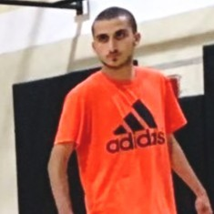
07 · PROOF
This isn't theory.
$1M
$2.1M
450%
5+
Client account scaled in 7 months (from $70K)
Marketing revenue across 8 accounts
Average client ROI on campaigns
Years leading operations & delivery
Hear it from the founder I worked for as COO — a 90-second video, unprompted, on camera.
Joey “Manu” Montefusco — Founder & CEO, The Madden Academy
Watch it at virtualsolutionsve.vercel.app/resume
virtualsolutionsve.vercel.app/handbook

Slide 9
LET'S TALK
If this is how you'd want your operation run —
let's talk.
Twenty minutes. I'll come with a specific read on where I'd start for your team. If I'm not the right fit, I'll tell you on the call.
Book a call virtualsolutionsve.vercel.app/resume#book
Email juliodomingosalvador@gmail.com
This handbook is the work sample.

